Slide 1


BRIDGING INTO A DIGITAL FUTURE
Notes:
Resting slide on screen before you begin presenting.

Slide 2
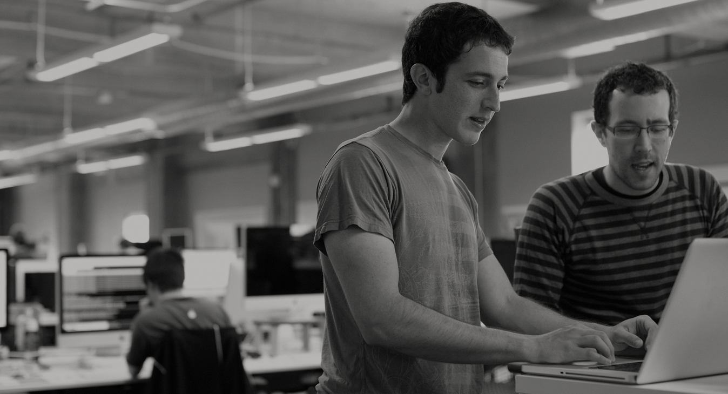

WE BELIEVE
Transforming how the world builds software will shape the future.
Notes:
At Pivotal, we believe Transforming how the world builds software will shape the future.
This is our core guiding principle that shapes our product and corporate strategy

Slide 3
Then
Now
Notes:
Lets begin the conversation with contrasting the past with the present. Using the auto industry as a backdrop, we examine at how industrialization changed manufacturing for good.

Slide 4
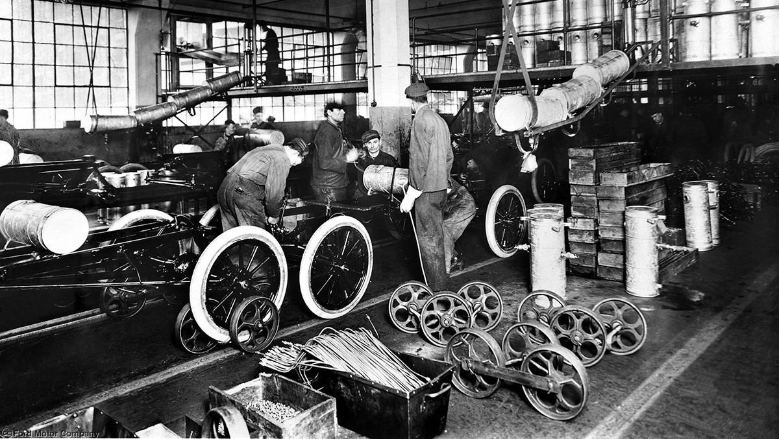
Notes:
In 1913, Henry Ford at Ford motors cut the time it took the produce a model T car by half kicking off a manufacturing revolution, birth of the auto industry and for the first time, cars became mainstream.

Slide 5
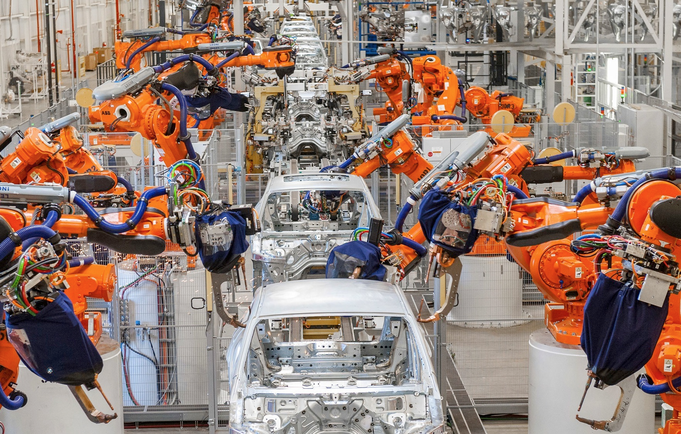
Notes:
Today most modern car factories roll out brand-new cars in 18 hours from sheet-metal to showroom with 100 times the number of features.
What enabled this massive change was automation and a NEW way of building cars started to emerge with incredible innovation that continues till date

Slide 6

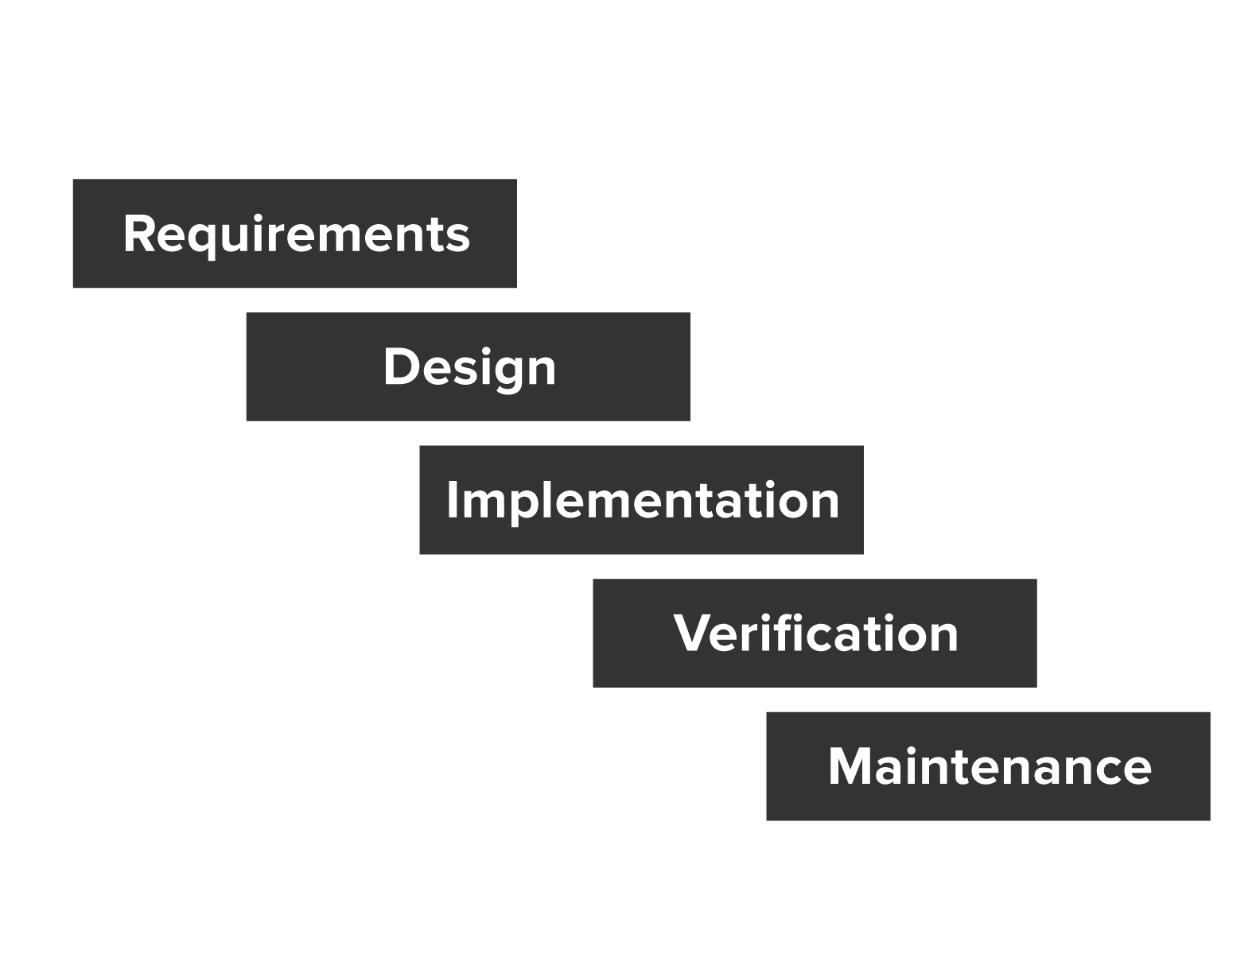
From idea to production: 6-9 months
Notes:
And if we look at how software is build and deployed today, for many enterprises, it still takes 6-9 months from an idea to deployment in production.
Many Dev and Ops teams foilow a version of the waterfall model with varying degrees of Agile/Scrum methodology applied to it. But that doesn't really change the fact that most of your developers are still waiting for the Release to train arrive. They can’t deploy to production whenever they want and are tied to release cycles that may happen as frequently as two weeks or as infrequently as every 3 mos.

Slide 7

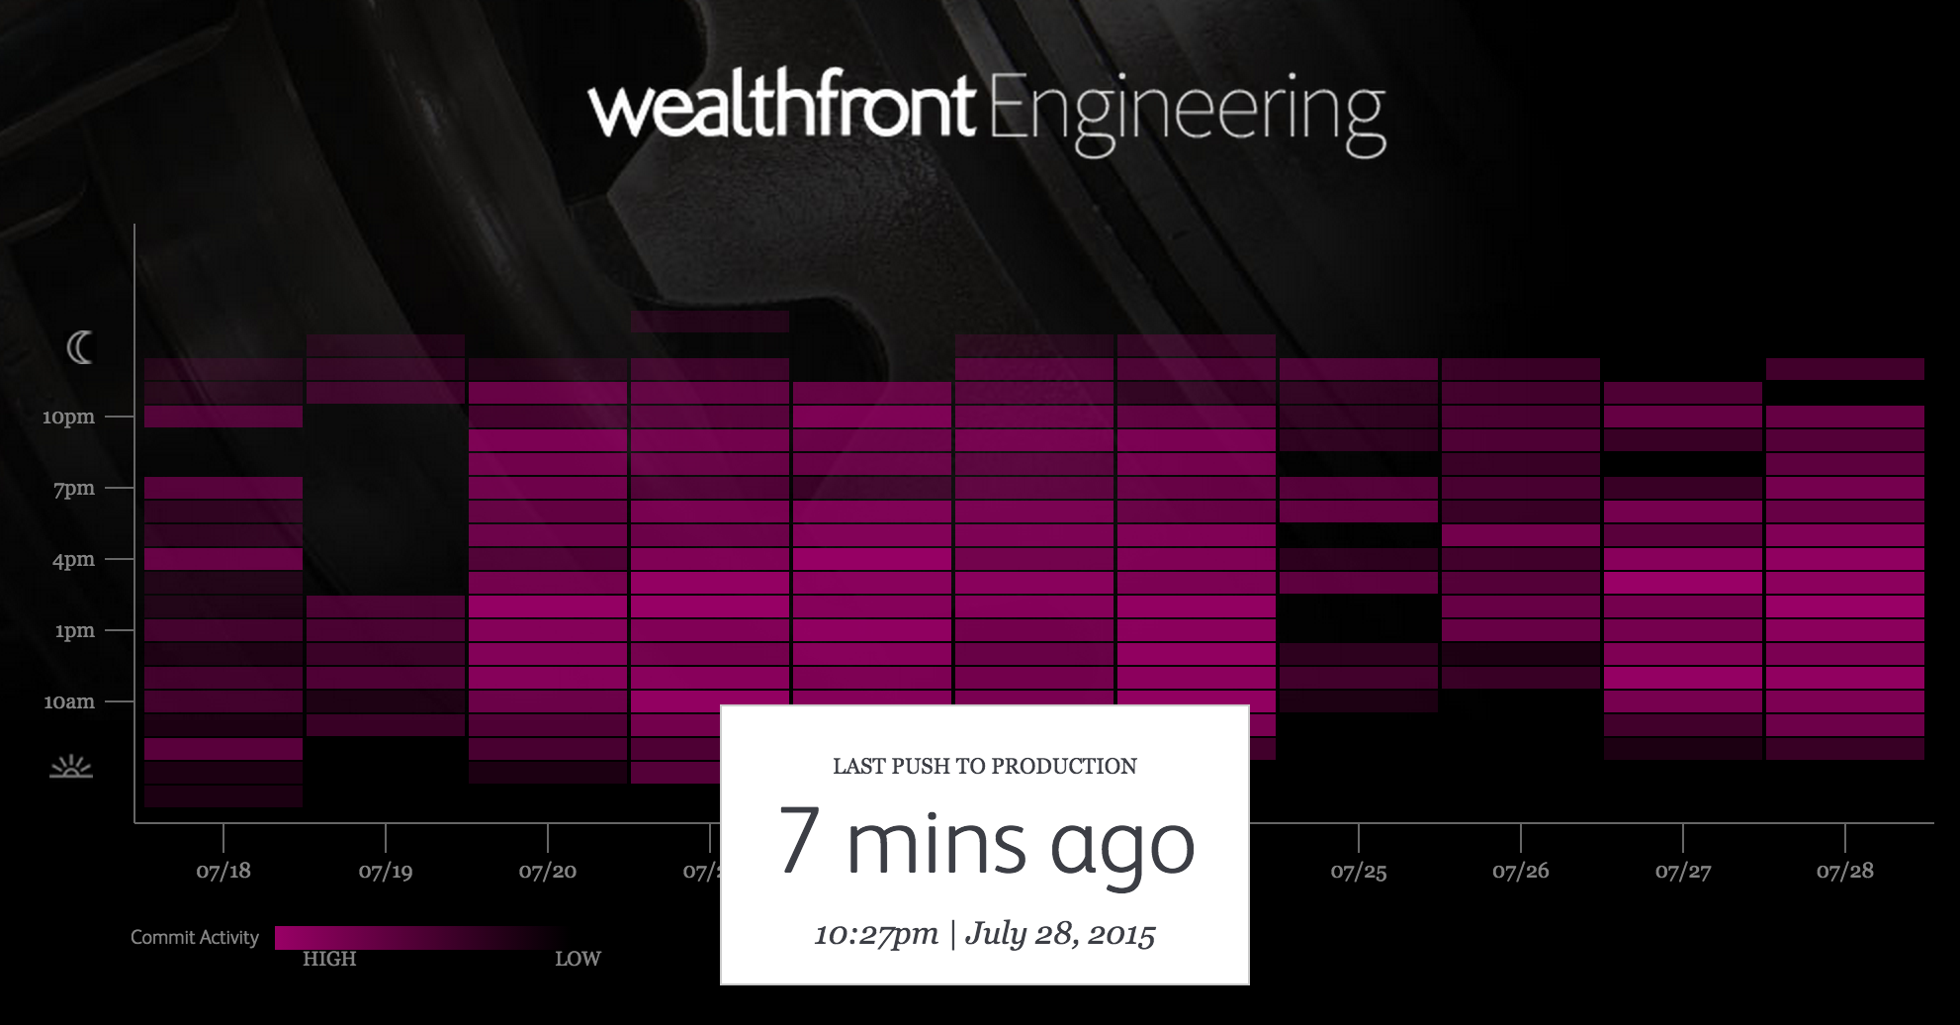
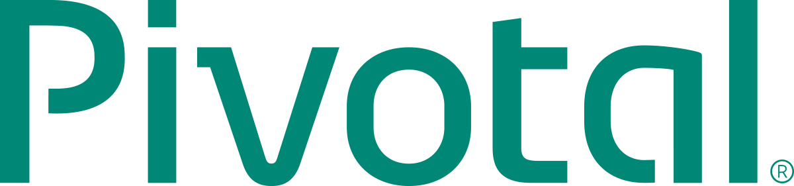
An idea in the morning, is running in production by evening
Notes:
By contrast you have the early innovators who have fully embraced and adopted an approach to software where There is no release cycle there is just a deploy button
A financial Wealth management company (Wealthfront in this case) proudly publishes on their external webpage how often they push code to production.
Wealthfront was founded in 2011 and now manages $2.5b and uses software as a competitive advantage

Slide 8
Ability
To Optimize
Building
Modern
Software
Speed
Notes:
And clearly the ability to go fast matters, but that's only HALF the story.
The other half is the ability to optimize, the ability to react to changes in near real-time. And building software in a modern way.
In the auto industry it wasn't just the ability to push out cars faster. It was about building cars in a way that’s predictable, automated and reliable.
In the software industry, its not about pushing code to production every 11 seconds (like amazon.com and many others), it’s that you are ALWAYS ready to push code to production. At any given time. And that changes how you build, deploy and approach software.

Slide 9

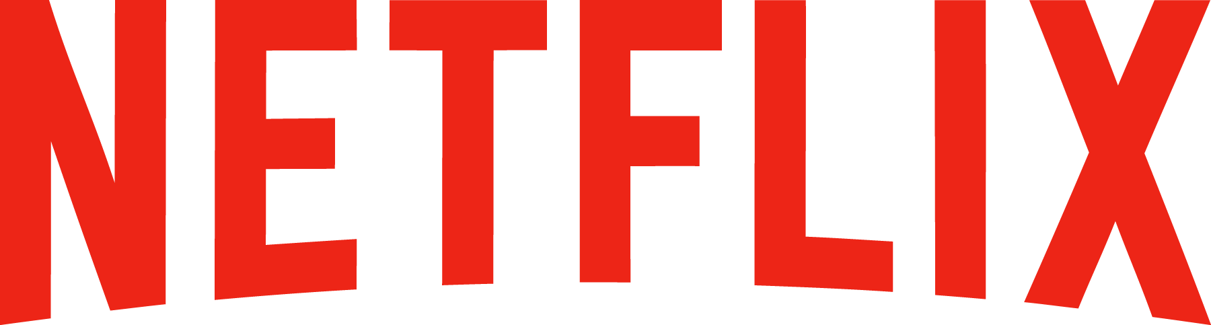
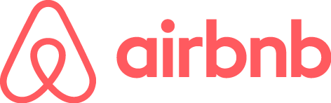

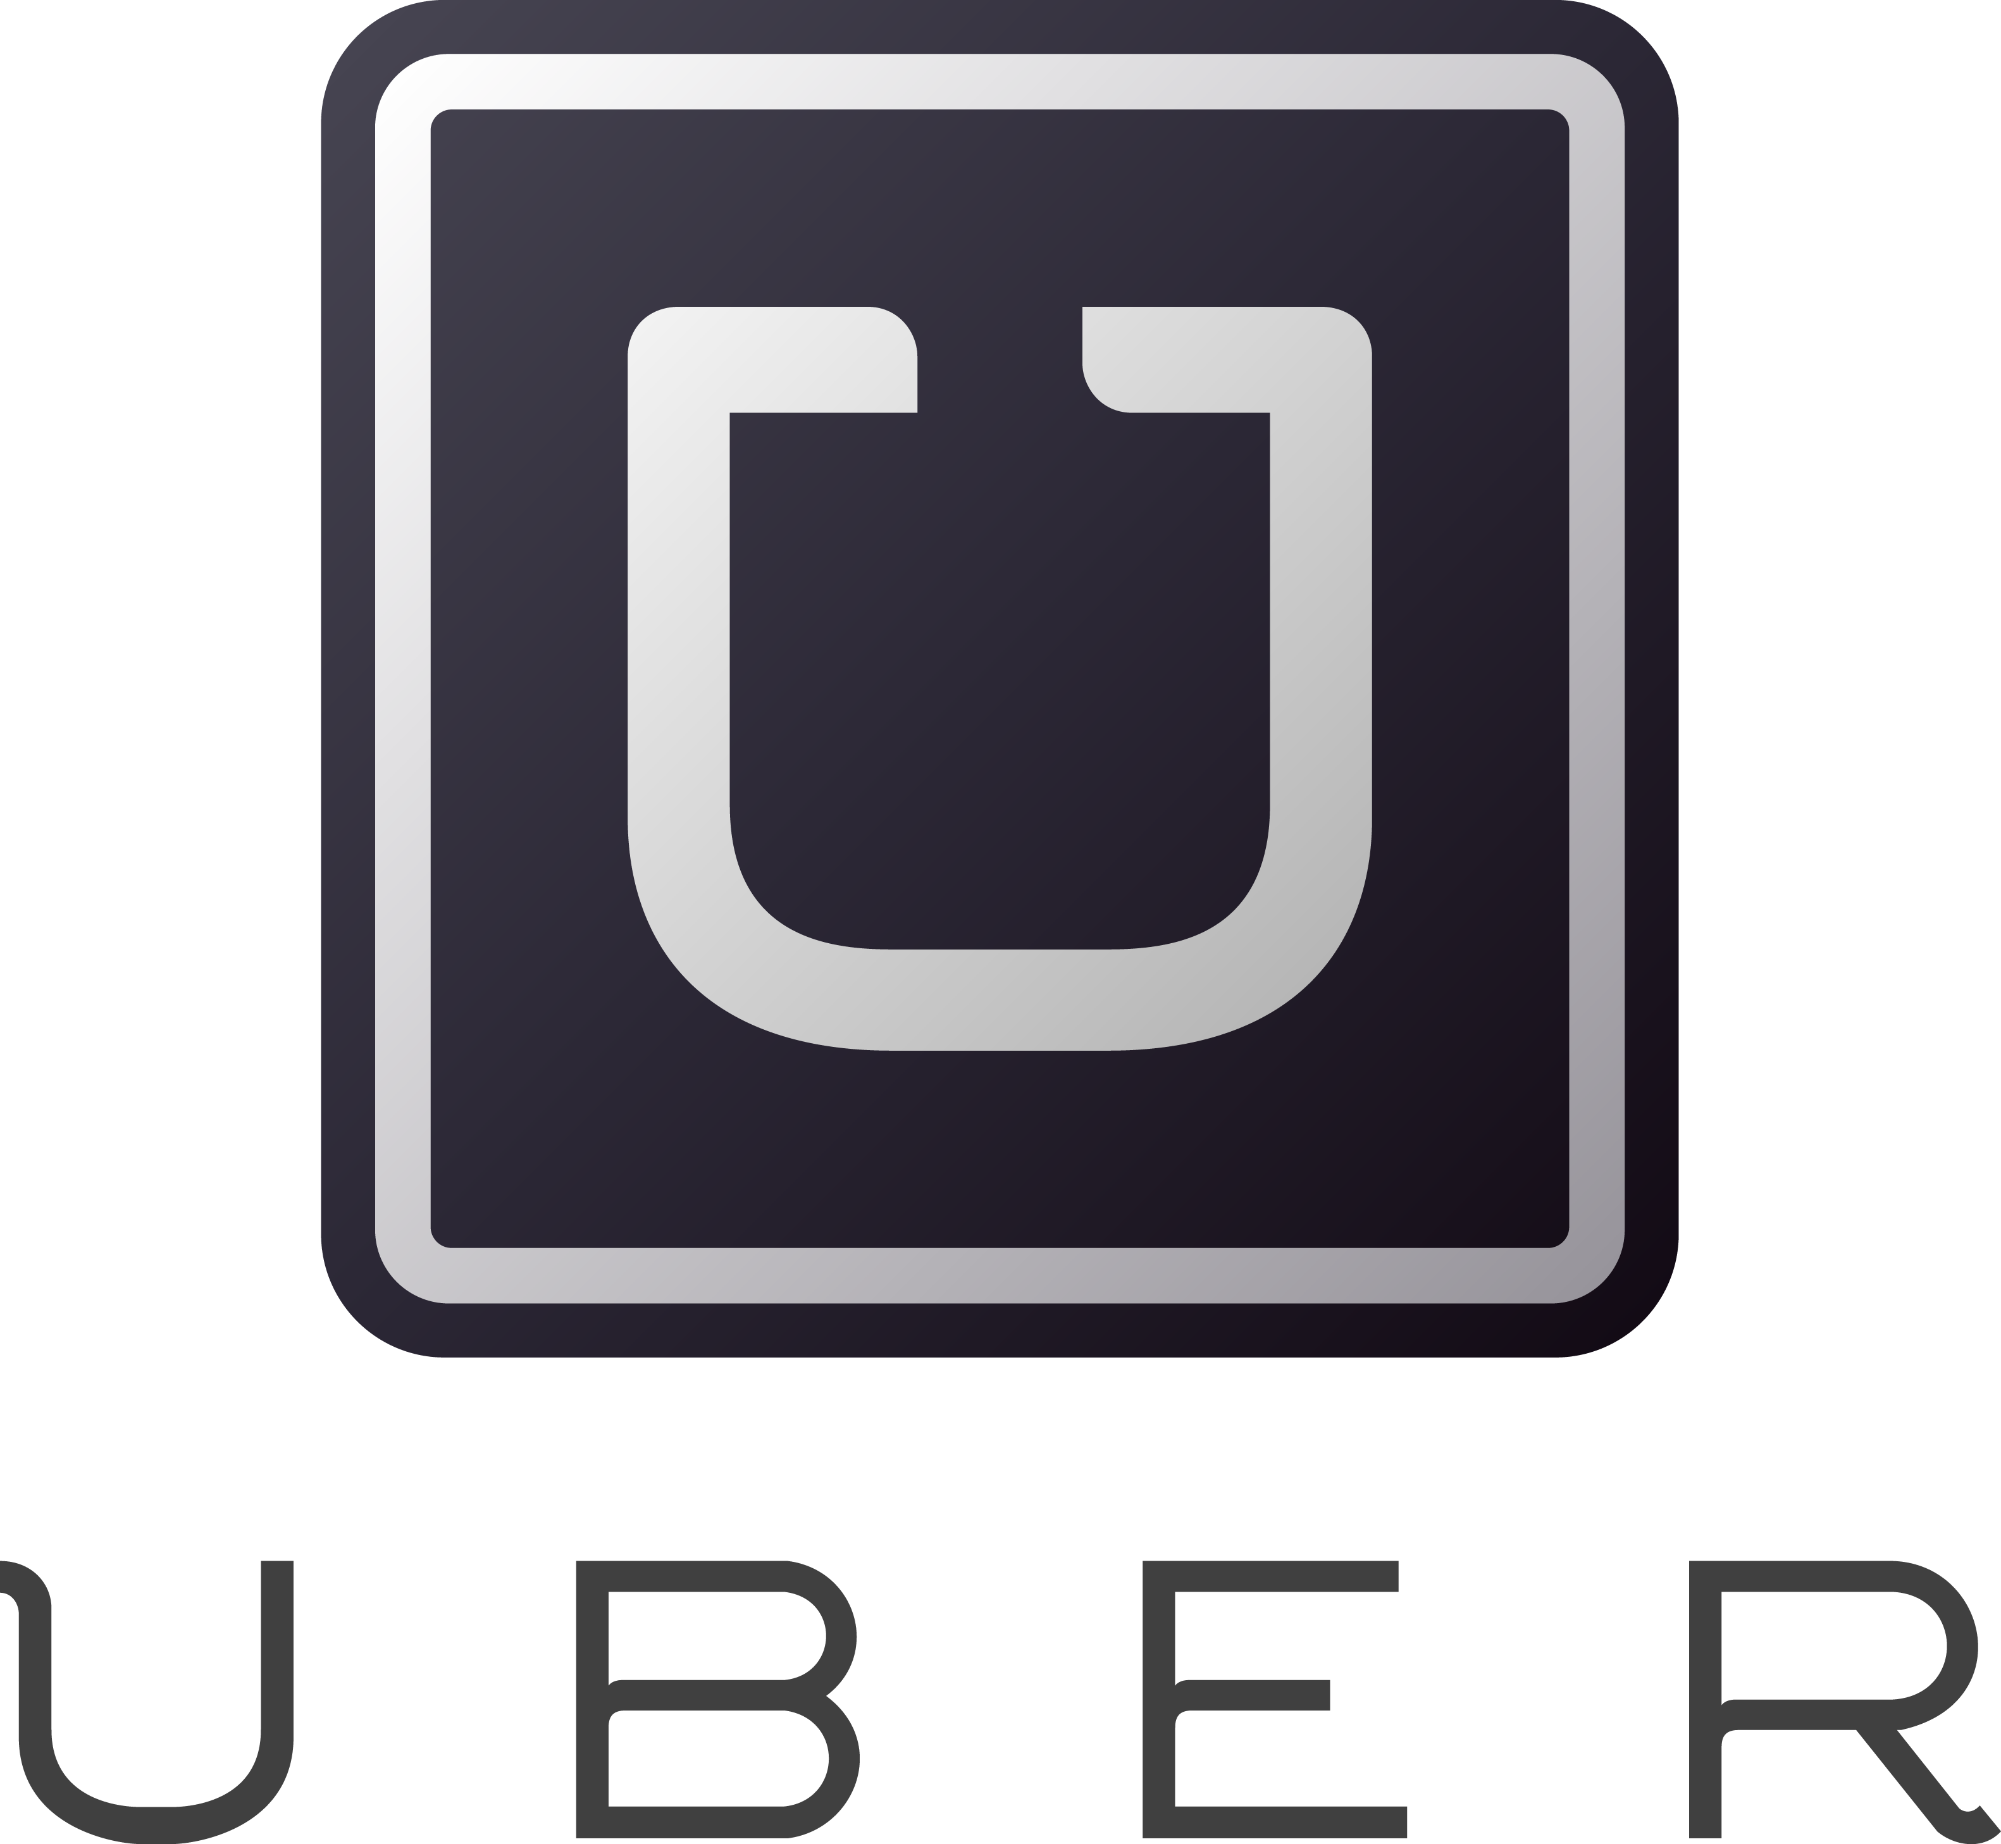

Software is changing INDUSTRIES
$4BN
Financial Services
$44BN
Entertainment
$30BN
Hotel
$31BN
Automotive
$66BN
Transportation
$3.2BN
Industrial Products
Notes:
Now, you might have seen some version of the story where several Silicon Valley companies are disrupting traditional industries and creating tremendous value.
Uber has no cars, AirBnB owns no real estate, Facebook doesn’t generate content and Amazon has no retail stores. This is all based on software. And that’s really a great story
[NOTE: these figures are approximate market cap as of 10/1/2016, and press reports for private companies]

Slide 10
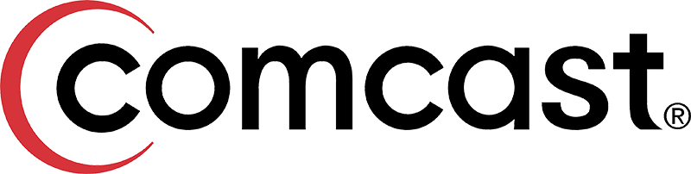
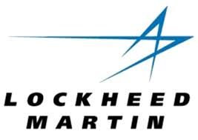
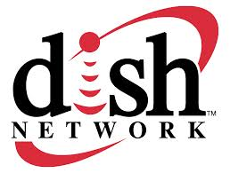
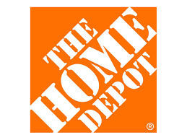
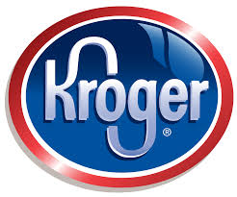
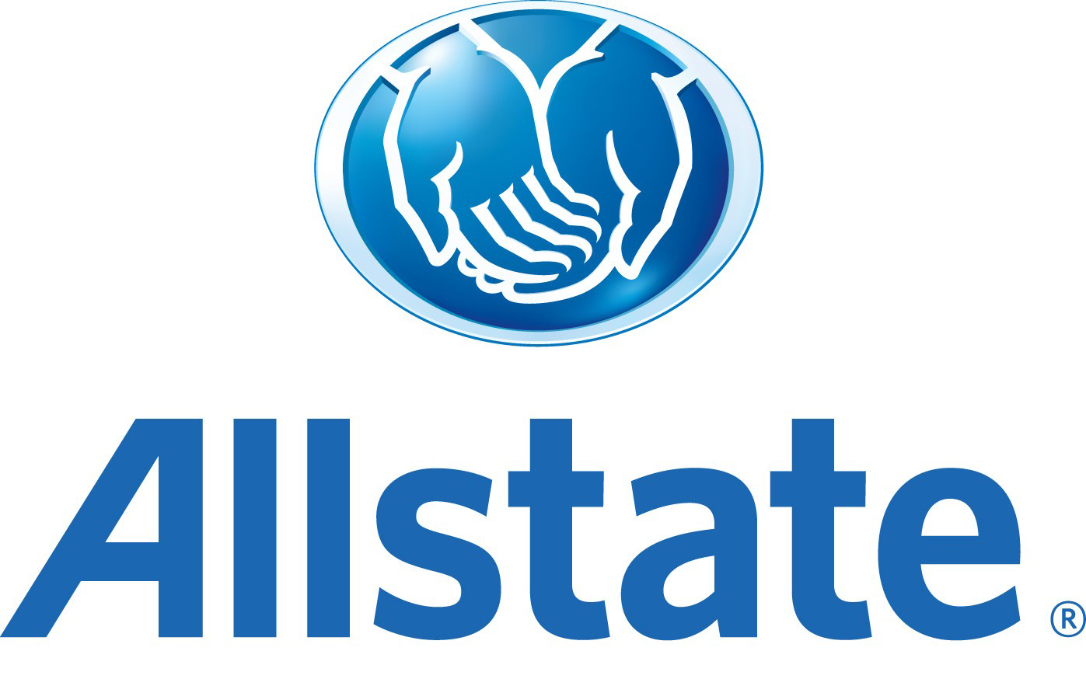
The enterprise REVOLUTION
$159BN
$70BN
$25BN
$158BN
$27BN
$25BN
Notes:
However, we don’t hear as much about the as the massive enterprise revolution at play.
These are brick and mortar, solid revenue generating, dividend paying companies that are all adopting Pivotal Cloud Foundry and changing the way they build and deploy software.
[NOTE: these figures are approximate market cap as of 10/1/2016]

Slide 11
The enterprise REVOLUTION
700+ apps
Spring + PCF
Re-writing software the modern way
Agile software transformation
DevOps adoption with PCF
Automated build pipeline
Major IT transformation
Notes:
Speak to each of the companies

Slide 12
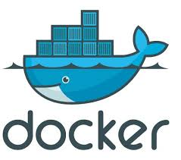

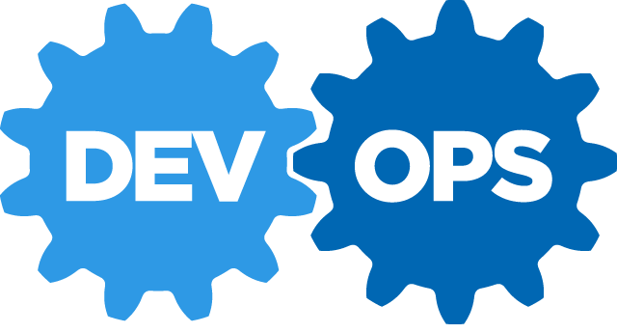
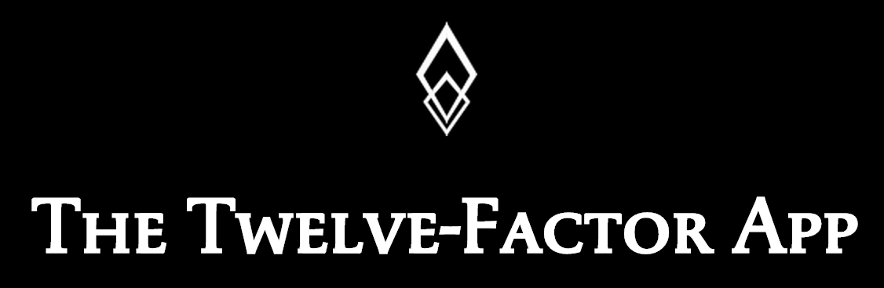


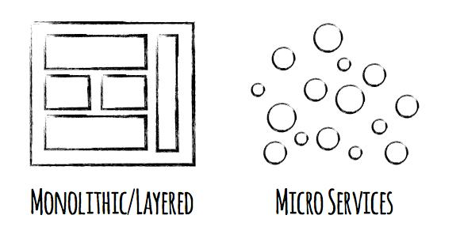


Software is CHANGING
Continuous Delivery
Spring Boot
Notes:
Software is changing industries but software itself is changing. You hear a lot about buzz-words and new technologies coming to play with ideas such as Microservices, DevOps, Continuous Delivery and of Containerization of workloads made popular by Docker

Slide 13
Continuous
Delivery
DevOps
Cloud Native
Micro services
Containers
Notes:
At Pivotal, we really see these trends as manifestations and facets of the same thing – that we call CLOUD NATIVE.
CLOUD NATIVE is the coming together of tools, frameworks and building modern software on a cloud infrastructure

Slide 14

Becoming Cloud Native
Notes:
How does one become cloud native and what does it mean ? - lets dig deeper

Slide 15
Then
Now
assume reliable infrastructure
assume fragile infrastructure
release code every 3 months
release code early and often
works in my environment
shared Dev & Ops responsibility
tightly coupled
loosely coupled

Slide 16
Assume FRAGILE infrastructure
Applications
Applications
?
Cloud Native Platform
Infrastructure
tight coupling
Infrastructure
?
?
✔
?
?
✔
?
?
✔
Notes:
Assume fragile infrastructure means - building reliable systems from unreliable components.
It means assuming fragile infrastructure that can and will fail. Netflix takes down an entire AWS region - US-West, US-East or US-midWest - every 4 weeks
In a traditional monolithic architecture applications are tightly coupled with the infrastructure. In a cloud environment, the state of your infra components can become unknown at anytime. EC2 instances die, storage is not persistent.
A cloud native platform fully expects infrastructure components to fail and plans for it. Using containerized technology and self-healing, it makes sure applications designed in a 12-factor way don’t see any impact from underlying failures.
It means no Ops tickets at 2am. It means canary deployments, it means zero-downtime.

Slide 17
DevOps
Continuous Delivery
Microservices
Not my problem
Separate tools, varied incentives, opaque process
Release once every 6 months
More Bugs in production
Tightly coupled components
Slow deployment cycles waiting on integrated tests teams
Shared responsibility
Common incentives, tools, process and culture
Release early and often
Higher Quality of Code
Loosely coupled components
Automated deploy without waiting on individual components
Notes:
Speak to each

Slide 18



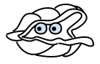
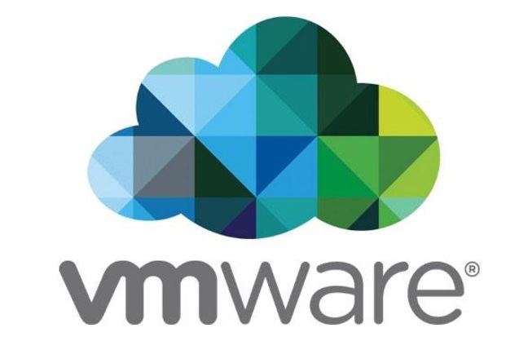
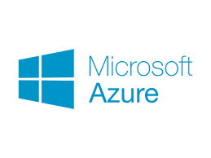

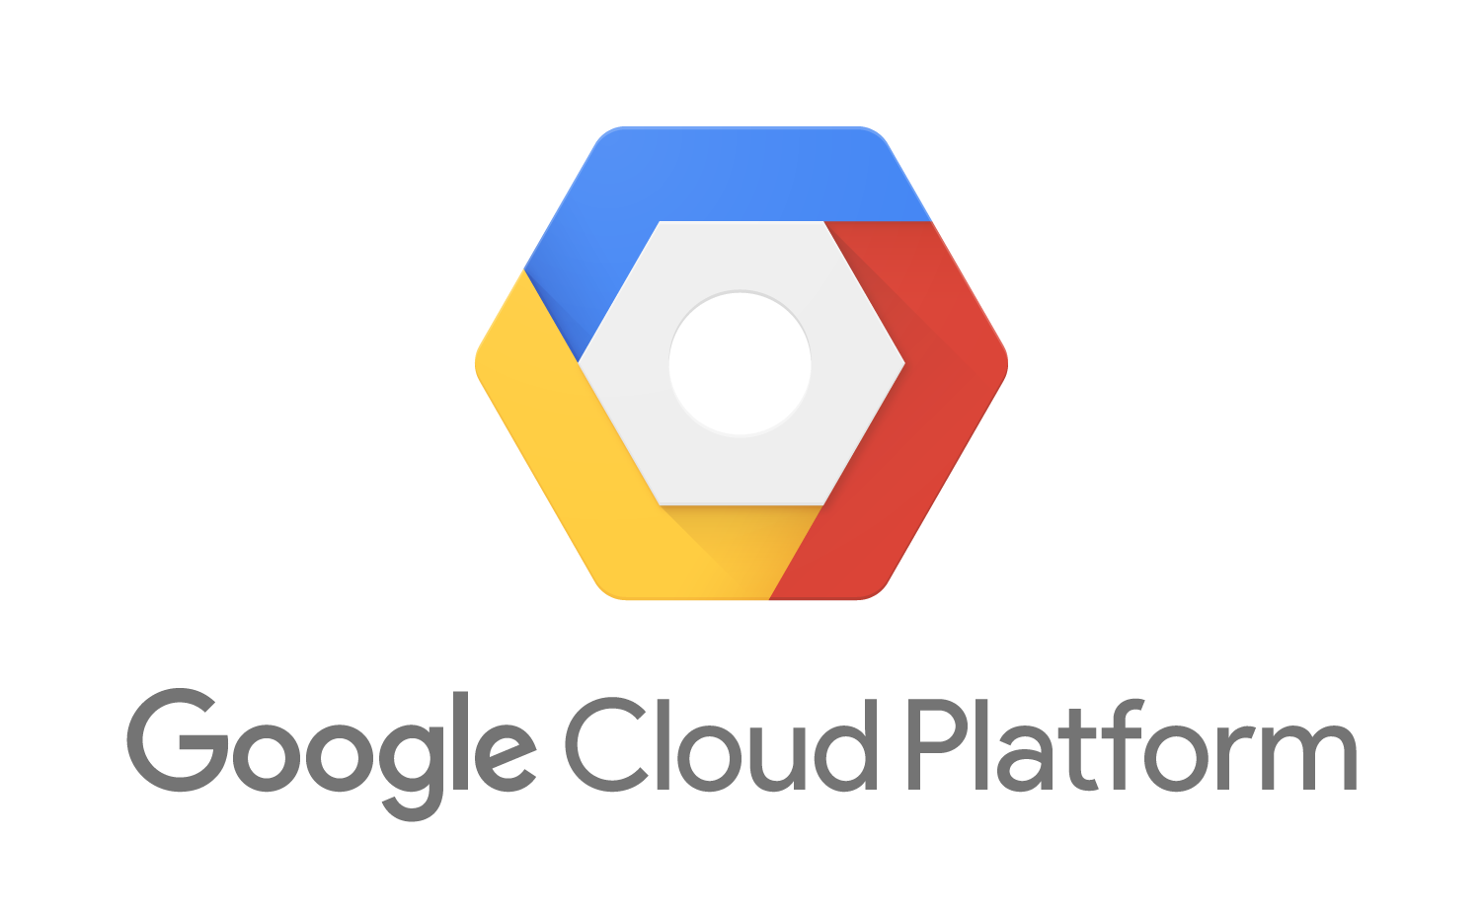
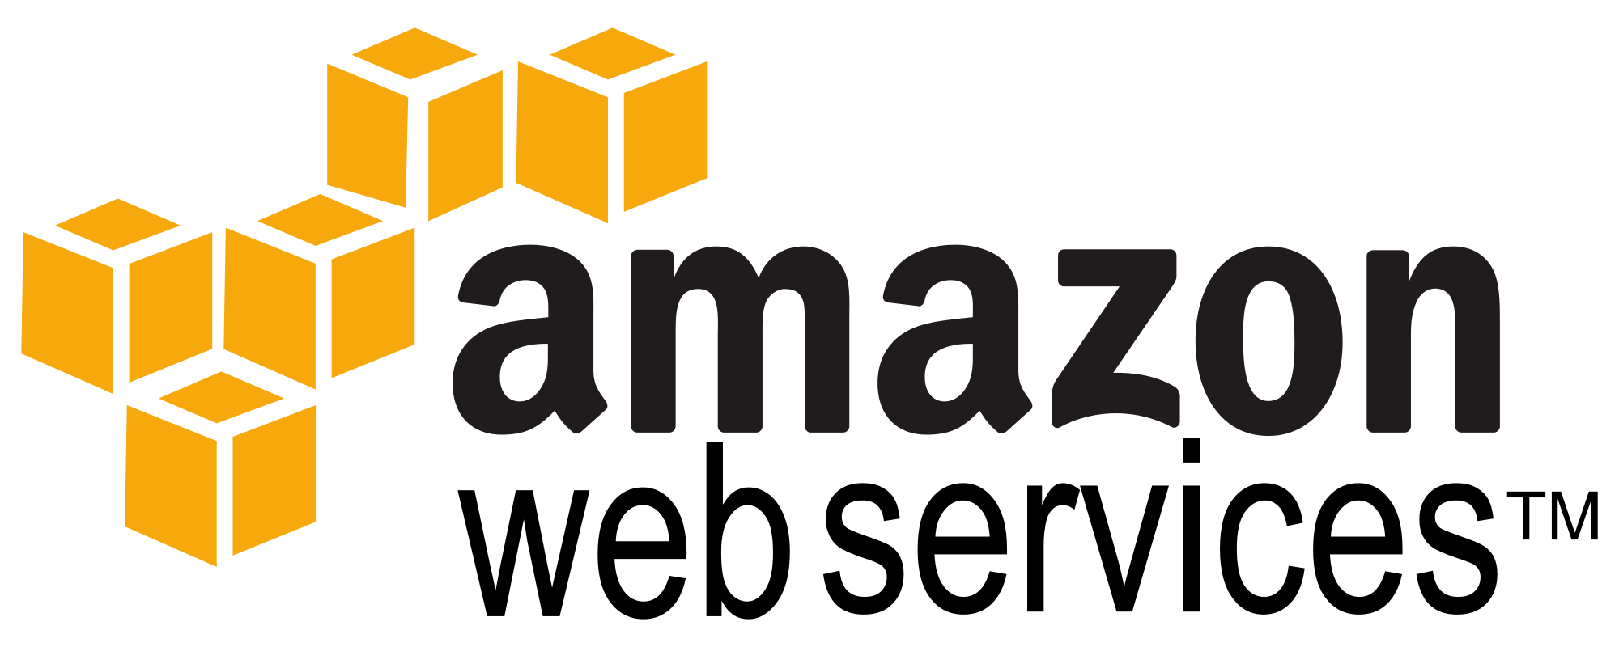
Culture
Cloud Native Framework
Tools
Application Framework
Spring Cloud
Spring Boot
Dev
Runtime Platform
Dev
IT Ops
Infrastructure Automation
IT Ops
BOSH
Infrastructure
IT Ops
AWS
VMWare
Azure
OpenStack
GCP
Notes:
Pivotal breaks down cloud native technology into 3 layers, which is all supported, reinforced and optimized by cloud native culture and Tools
This may seem a lot to take initially, so lets break it down later by layer.
Starting at the top - But before we do, lets talk about Developers

Slide 19
The developer dream haiku
Here is my source code,
Run it in the Cloud for me,
I do not care how
Notes:
An important and in-demand resource these days – Your developers. This is what they really want

Slide 20
Software developers spend too much time NOT writing software
Design and Coding
Brainstorming
Administrative tasks
Managing Environments
Waiting for Test/Build
Average Hours/Week
Sources: “Electric Cloud LinkedIn Survey to software developers”
Notes:
And here’s the reality.
You have a precious resource that’s spending TOO much of their time, not doing what you hired them to do. And for good reason.

Slide 21
Culture
Cloud Native Framework
Tools
Application Framework
Spring Cloud
Spring Boot
Dev
Runtime Platform
Dev
IT Ops
Infrastructure Automation
IT Ops
BOSH
Infrastructure
IT Ops
AWS
VMWare
OpenStack
Notes:
The Application framework is all about letting developers focus on building software.

Slide 22

Application Framework
Spring Cloud
Spring Boot
Dev
Spring Cloud
Spring Boot
Designed for fragile infrastructure in partnership with Netflix
From 0 to app in < 5 min
Notes:
This month alone, there were over 1.6m downloads, 8m YTD, growing at 10% m/o/m key new projects. Why? because developers love Boot - It’s zero config, super lightweight, runtime ideal for single purpose single process applications aka microservices. With Boot you can go from 0 to app in <5minutes
But remember the concept of fragile infrastructure and designing for failure? How do you wire up all these little processes into a cohesive app that works even when things go wrong?
Luckily Netflix has solved some of these problems at web scale ( their OSS stack is great, but not so easy to use). Swe took that core functionality and built spring cloud. All the power of eureka, hysterix, and config server built as spring modules. As easy adding an annotation and secure for the enteprrise
So awesome even netflix is using it now now we have the app devs able to run super fast and make lots of microservices and tie them together to make amazing apps with spring boot and cloud
But this actually created a huge ops problem …..

Slide 23
The IT Operator reality
It's not enough just to deploy something
That's only Day One
You have to deploy again and again and again

Slide 24
IT Ops spend time building snowflakes
Request VMs
Request Network
Request Software Install
Request Database
Random Network Troubleshooting
DAYS
14
4
4
8
6
Nearly 6 months later
11
40
14
60
2
Random Middleware/OS Troubleshooting
Develop App
User Acceptance Testing
QA/Production Deploy Pipeline
Scale Up/Down

Slide 25
Culture
Cloud Native Framework
Tools
Application Framework
Spring Cloud
Spring Boot
Dev
Runtime Platform
Dev
IT Ops
Infrastructure Automation
IT Ops
BOSH
Infrastructure
IT Ops
AWS
VMWare
OpenStack
Notes:
Enter CF runtime platform

Slide 26
Auto scaling
Container management
Self service
Runtime Platform
Dev
IT Ops
Self healing
Integrated logging
Application Performance Management
Notes:
So Spring Boot/Cloud meant create apps fast – But Dev & Ops is asking Day2 questions -
How do you do logging, routing, apm, scaling, and lifecycle management of all these apps.
Enter CF Runtime
best in class container management
integrated agentless logging
with APM
auto scaling
Effortless runtime with minimum human operational overhead. We run 1000s of apps and 10,000s containers on PWS with 6 guys.
But we realized that stopping there wasn't enough

Slide 27
manage services not servers
no maintenance windows
embedded OS
zero downtime
infra as code
multi cloud support
Infrastructure Automation
IT Ops
BOSH
Infrastructure
IT Ops
AWS
VMWare
OpenStack
Notes:
We needed to orchestrate the infrastructure to support this runtime. CF tells the infrastructure what to do and has a common API to support various infra types – AWS, vSphere, Openstack, Azure
When things break (and they will), the notion of self healing kicks in. There is no calling IT Ops, opening tickets, adding new VM’s, creating VM templates, upgrading Operations system, all that is automated and CF takes care of that.
And that gives you - Zero downtime, No maintenance windows
No managing OS upgrades, No managing VM’s
An amazing Operations savings story. What can you do with that time and labor savings ?

Slide 28
Culture
Cloud Native Framework
Tools
Application Framework
Spring Cloud
Spring Boot
Dev
Contract: 12 Factor App
Runtime Platform
Dev
IT Ops
Contract: BOSH Release
Infrastructure Automation
IT Ops
BOSH
Contract: Cloud Provider Interface
Infrastructure
IT Ops
AWS
VMWare
OpenStack
Notes:
And all of this is enforced through strict API contracts that allow you to go FAST and be safe.

Slide 29
The future…is here
DevOps
Spring Boot
Modern Software
Talent shortage
25% of Global 2000
4.2m downloads/month
Cloud Native
Continuous Innovation
Notes:
In conclusion,
Cloud native is here - Its not iphone version 1, its not hipster software
We see massive adoption with large enterprise
Trends show –
DevOps
SpringBoot
Software
Talent shortage

Slide 30

Next Steps
App Dev.
IT Ops
Cloud Native Workshop
Developer Training
Quick Start PWS
Microservices University
Cloud Native Workshop
Proof of Concept
Migration Strategy
High Availability Architecture

Slide 31
Let’s build something MEANINGFUL
Notes:
From Silicon Valley…

Slide 32
Q&A

